Slide 1

COMPUTATIONAL MATERIALS SCIENCE AND ENGINEERING GROUP SCHOOL OF CHEMICAL ENGINEERING, NTU ATHENS
Established 2002
Mission:
Development of new, efficient computational methods for the quantitative understanding and prediction of the properties of materials through modelling and simulation at atomistic and mesoscopic levels.
Application of these methods to materials of technological interest.
Contribution to the solution of materials design problems, in collaboration with international industry.

Slide 2
THE COMPUTATIONAL MATERIALS SCIENCE AND ENGINEERING GROUP AT NTUA
Group Director Doros N. Theodorou
Diploma Thesis Students Leonidas Konstadopoulos Tzortzis Koulaxizis Alexandros Philippas George Sakellion Nikos Sigalas Christina Zois
Postdoctoral associates Stefanos Anogiannakis Gregory Megariotis Aris Sgouros
Ph.D. Students Vassilis Georgilas Spyros Kallivokas Apostolis Lakkas Constantinos Revelas
Close Collaborators Takis Kolokathis, NTUA Loukas Peristeras, NCSR “Demokritos” Panos Petris, NTUA Christos Tzoumanekas, NTUA Niki Vergadou, NCSR “Demokritos” Georgios Vogiatzis, T.U. Eindhoven
Master’s Student Fotis Venetsanos

Slide 3
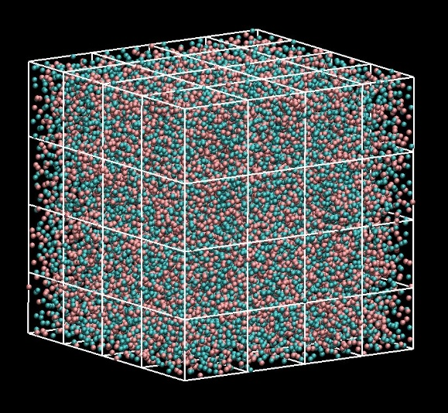


Mixing Thermodynamics from molecular simulation
Stefanos Anogiannakis, Panos Petris
volume V
Analysis of fluctuations
provides ⟨N_{i}⟩, ⟨N_{j}⟩, ⟨N_{i} N_{j} ⟩ in the volume V, from which the Kirkwood-Buff integrals can be calculated
V₀
N_{i} , N_{j} : numbers of molecules of species i and j in a reference volume V.
δ_{ij} : Kronecker delta
LJ Mixture in NpT ensemble
i
j
Galata, A. A.; Anogiannakis, S. D.; DNT Fluid Phase Equilibria 2017, 470, 25. Petris, P.; Anogiannakis, S.D.; DNT J.. Phys. Chem. B 2019, 123, 247.
Notes:
Rigorous relations between the derivatives of the chemical potentials with respect to mole fraction and the Kirkwood-Buff integrals.

Slide 4
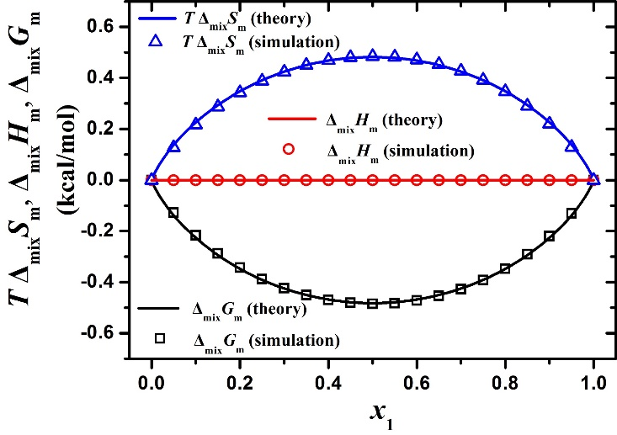
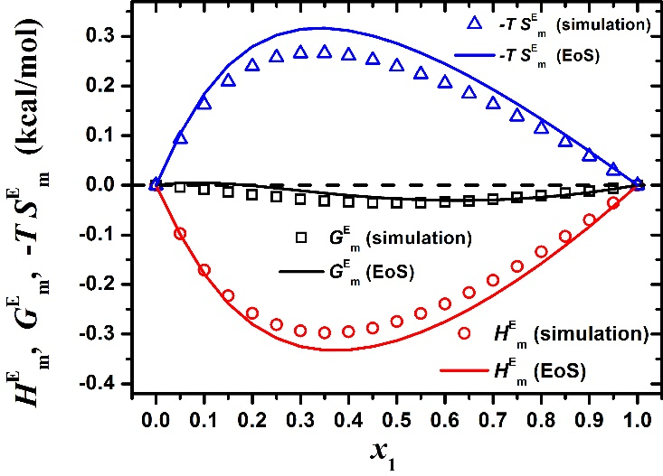
Δ_{mix}H, Δ_{mix}G, and Δ_{mix}S – Ideal and Real LJ Mixtures
Ideal LJ Mixture
Real LJ Mixture
Mixing thermodynamic properties
Excess thermodynamic properties (simulation)
modified Benedict-Webb-Rubin (mBWR) Equation of State
directly from MD
KB integrals
Galata, A. A.; Anogiannakis, S. D.; DNT Fluid Phase Equilibria 2017, 470, 25. Petris, P.; Anogiannakis, S.D.; DNT J.. Phys. Chem. B 2019, 123, 247.
Notes:
Nonideal mixture: Exothermic mixture (negative deviations from ideal solution behavior)

Slide 5
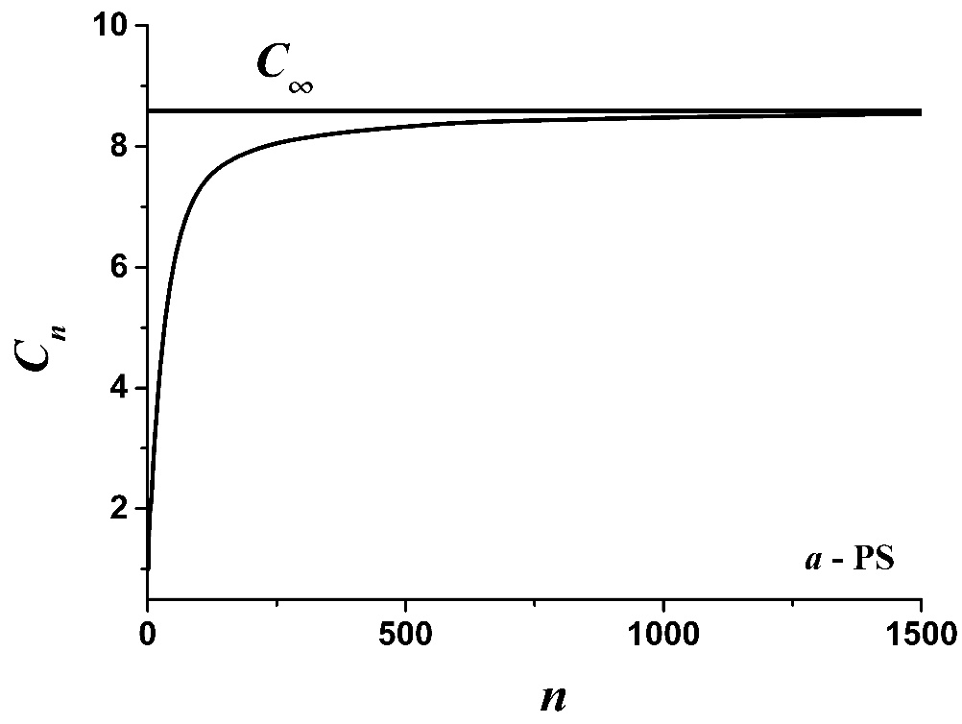
Predicting Conformational Stiffness from Atomistic Simulation
Stefanos Anogiannakis, Nikos Sigalas
Flory’s characteristic ratio
R
Unperturbed Chain
C_{n} reaches plateau value, C∞, for long chains
n
l
number of backbone bonds
skeletal bond length
stiffer chains
Rubinstein, M.; Colby, R. H. Polymer Physics; Oxford University Press: New York, 2003.

Slide 6
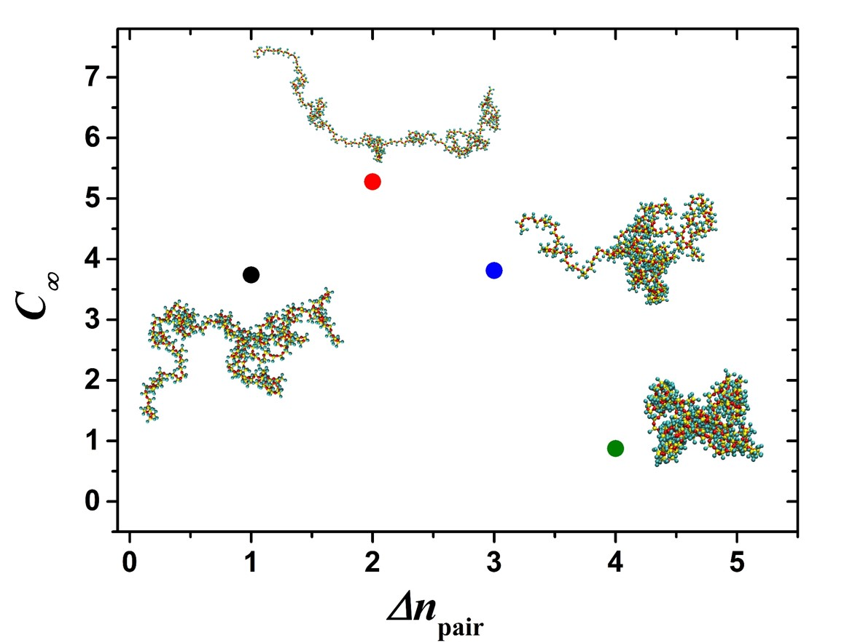
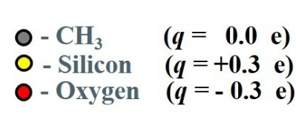
Definition of “local” interactions - Δn_{pair}
Δn_{pair} = 1
Δn_{pair} = 2
Δn_{pair} = 3
Δn_{pair} = 4
Tzounis, P.-N.; Anogiannakis S. D.; DNT.; Macromolecules 2017, 50, 4575-4587. Tzounis, P.-N.; Argyropoulou, D.V.; Anogiannakis, S.D.; DNT. Macromolecules 2018, 51, 6878-689

Slide 7
Estimation of Stiffness (Characteristic Ratio)
Polymer | T (K) | ↑l (Å) | C∞ (single unperturbed chain MC sampling) | C∞ (melt simulations) | C∞ (experimental measurements)
PE | 450 | 1.54 | 8.25 [1] | 8.26 ± 0.15 [2] | 7.25 [3]
i - PP | 450 | 1.54 | 5.53 [1] | 5.49 ± 0.33 [4] | 6.15 [3]
a - PS | 450 | 1.54 | 8.60 [1] | 8.70 ± 0.1 [5] | 8.50 [6]
PEODME | 450 | 1.46 | 5.25 [1] | 5.40 [7] | 5.50 [8]
PDMS | 298 | 1.64 | 5.28 [1] | - | 5.81 [9]
a - PMMA | 413 | 1.54 | 7.35 [1] | - | 8.22 [9]
PLA | 413 | 1.43 | 6.04 [1] | - | 6.70 [10]
[1] Tzounis, P.-N.; Anogiannakis S. D.; DNT Macromolecules 2017, 50, 4575-4587.
[2] Foteinopoulou, K. et al., J. Phys. Chem. B 2009, 113, 442-455.
[3] Fetters, L. J. et al., Macromolecules 2002, 35, 100096-10101.
[4] Logotheti, G. E. et al., Macromolecules 2007, 40, 2235-2245.
[5] Mulder, T. et al., Macromolecules 2009, 42, 384-391.
[6] Mark, J.; Ngai, K.; Graessley, W.; Mandelkern, L.; Samulski, E. Physical Properties of Polymers; Cambridge University Press: Cambridge, 2003.
[7] Wick, C. D.; Theodorou, D. N., Macromolecules 2004, 37, 7026-7033.
[8] Annis, B. K. et al., Macromolecules 2000, 33, 7544-7548.
[9] Fetters, L. J.; Lohse, D. J.; Colby, R. H. Chain dimensions and entanglement spacings; in Physical Properties of Polymers Handbook; Mark, J. E.; Springer: Berlin, 2006, pp. 447-454.
[10] Aura, R.; Lim, L.–T.; Selke, S. E. M.; Tsuji, H. Poly(Lactic Acid) Synthesis, Structures, Properties, Processing and Application, Wiley: New Jersey, 2010.

Slide 8









Equilibrating polymer melts: Connectivity-Altering MC
Loukas Peristeras, Aris Sgouros
PE T=450 K, p = 1 bar
Karayiannis, N.; Mavrantzas, V.G., DNT, Phys. Rev. Lett. 2002, 88, 105503.
TraPPE force field: Martin, M.G.; Siepmann, J.I. J. Phys. Chem. B 1999, 103, 4508-4517.
17.8 nm
Notes:
Some things we have accomplished in molecular modeling of polymers

Slide 9
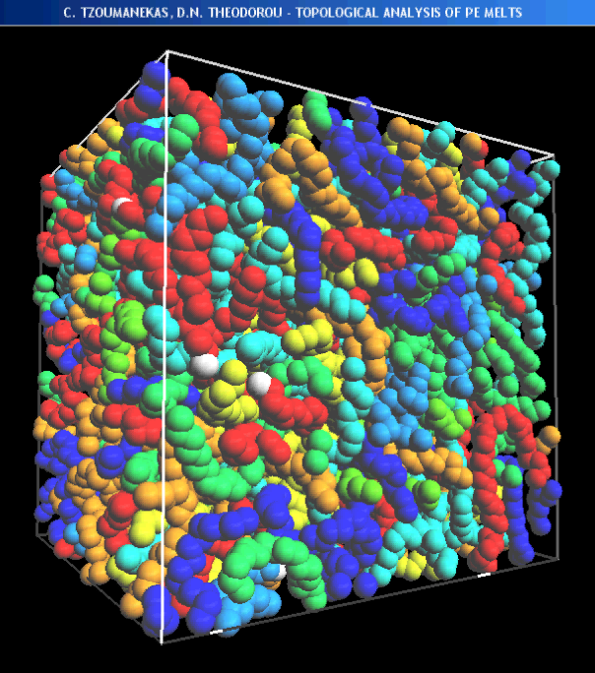
Entanglement analysis in polymer melts
Christos Tzoumanekas, Stefanos Anogiannakis
CReTA Algorithm Tzoumanekas, C.; DNT Macromolecules 2006, 39, 4592.
Example: C₁₀₀₀ PE, 450 K, 1 atm
Similar strategies: Everaers, R.; Sukumaran, S.K.; Grest, G.S.; Svaneborg, C.; Sivasubramanian, A.; Kremer, K. Science 2004, 303, 823.
Kröger, M. Comp. Phys. Comm. 2005, 168, 209.

Slide 10
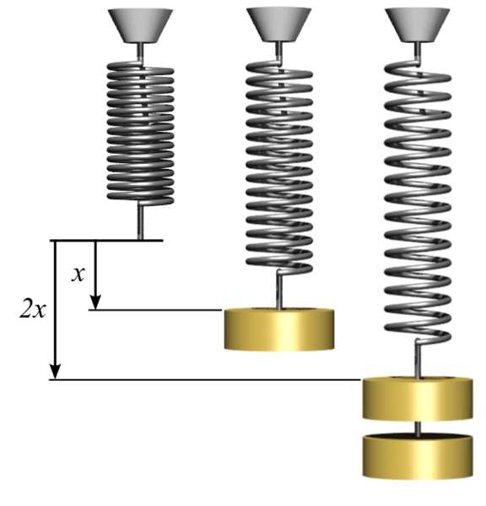
Mesoscopic simulations of polymer melt dynamics
Aris Sgouros, Grigoris Megariotis, George Vogiatzis, Alex Philippas
Effect of entanglements
introduced by slip-springs.
strand slip-spring end-point crosslink internal
nodal point
nodal point: ~50 skeletal atoms
A slip-spring connects two internal nodal points of two different polymer chains.
Discrete hopping dynamics is used for the ends of slip-springs.
EMSIPON Code
Notes:
The polymer is envisioned as a network of strands crosslink points, end points, and internal nodal points. The effects of entanglements are introduced by slip springs between chains. A chain may slide through a slip spring through which it passes. Crosslinks cannot slip though slip springs. In the presence of nanoparticles, some internal nodes will be characterized as adsorption points and some end points as grafting points. Crosslinks are determined through the random crosslinking procedure described under Task 1.2. The number of entanglements (slip links), on the other hand, is chosen so as to be consistent with the molar mass between entanglements, Me, in the linear melt.

Slide 11
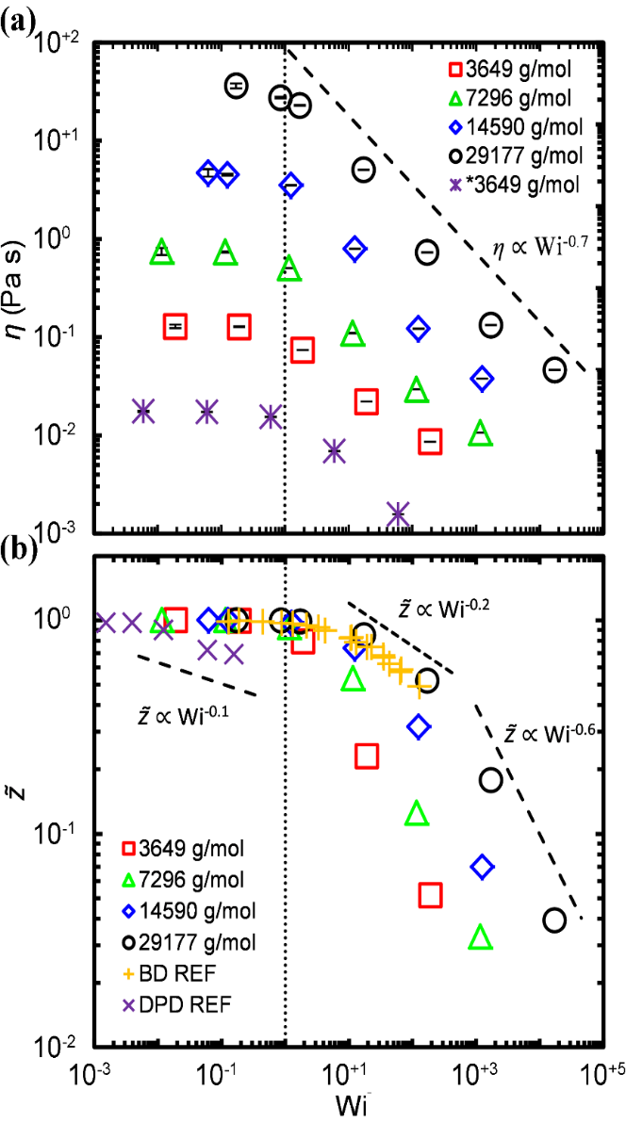
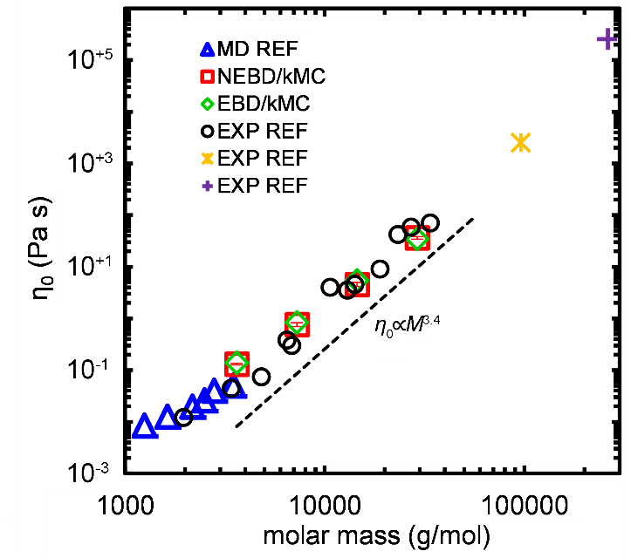

Viscoelastic properties of polymer melts
Brownian dynamics/kinetic Monte Carlo simulation
Mesoscopic free energy function incorporating intrachain spring, slip-spring, and nonbonded contributions.
PE 450 K, 1 bar
Vogiatzis, G.G.; Megariotis, G.; DNT Macromolecules 2017, 50, 3004 Sgouros, A.P.; Megariotis, G.; DNT Macromolecules 2017, 50, 4524 Megariotis, G.; Vogiatzis, G.G.; Sgouros, A.P.; DNT. Polymers 2018, 10, 1156.

Slide 12
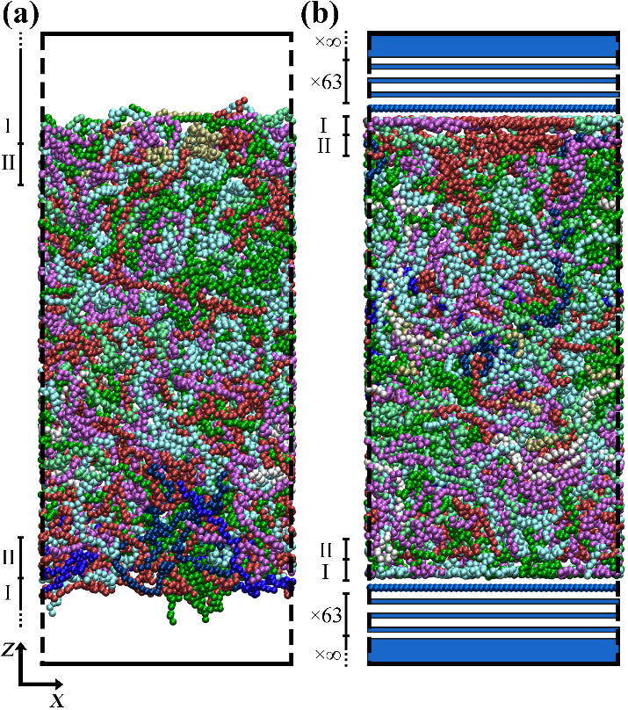
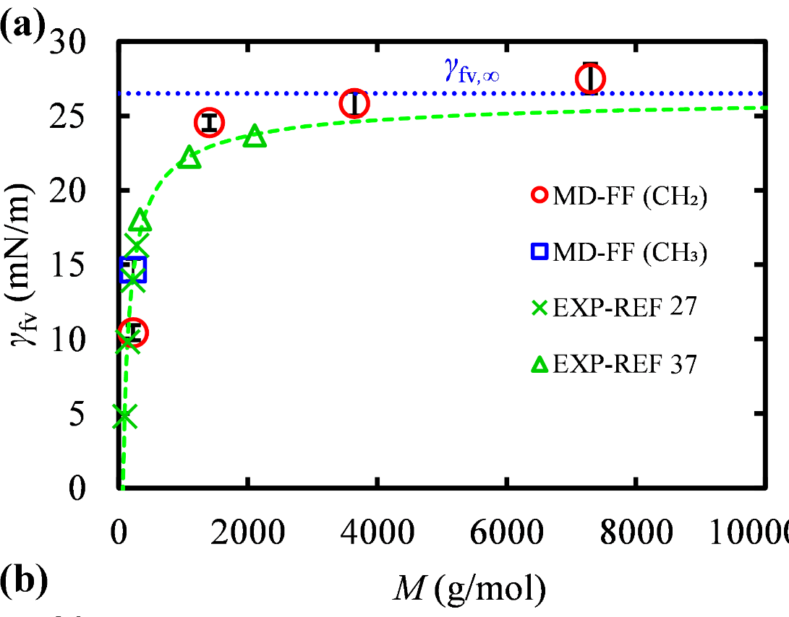
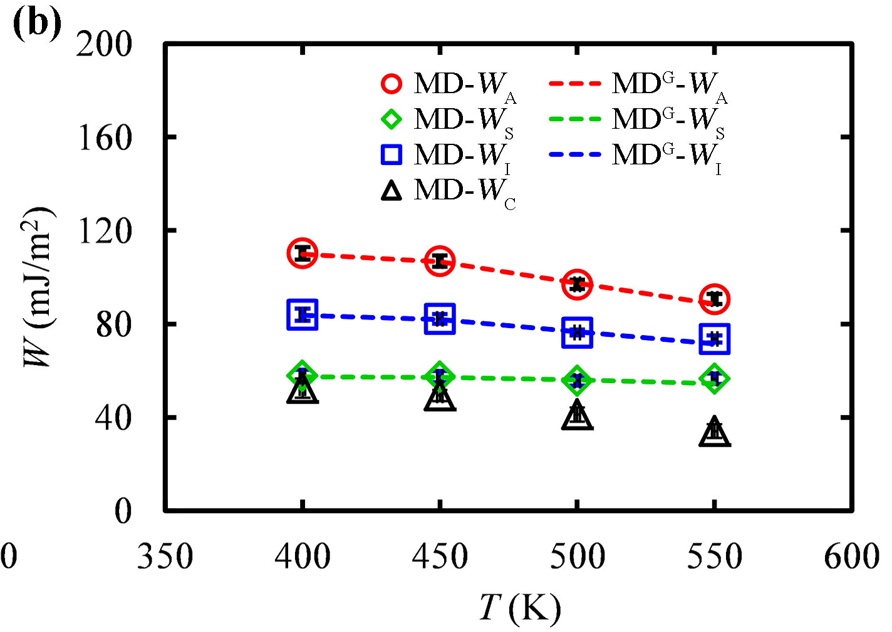
Polymers at Interfaces
Aris Sgouros, G. Vogiatzis
polyethylene (f)/graphite (s)
v
T=450 K
W_{A}=γ_{fv}+ γ_{sv}− γ_{fs} work of adhesion
W_{I} =γ_{sv}− γ_{fs} work of immersion
W_{S}=γ_{sv}−γ_{fs} − γ_{fv} work of spreading
W_{C}=2γ_{fv} work of cohesion
Sgouros, A.P.; Vogiatzis, G.G.;Kritikos, G.; Boziki, A.; Nikolakopoulou, A.; Liveris, D.; DNT Macromolecules 2017, 50, 8827

Slide 13
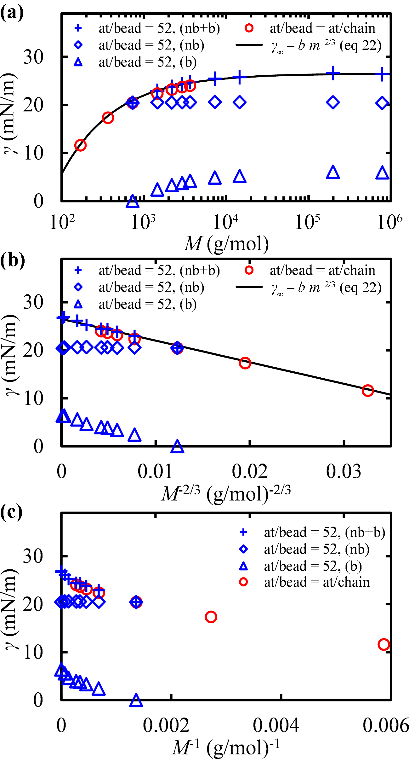
BD/kMC+SGT Simulations of Polymers at Interfaces
Aris Sgouros
Molar mass dependence of surface tension correctly captured through bonded contributions between C₅₂ coarse-grained beads
C₅₂
Sgouros, A.P.; Lakkas, A.T.; Megariotis, G.; DNT Macromolecules 2018, 51, 9798.

Slide 14
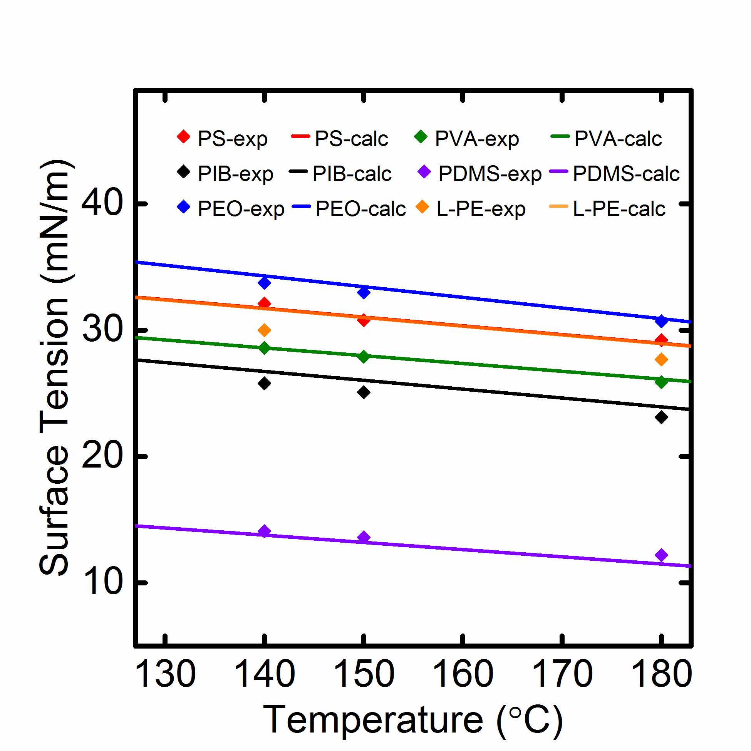
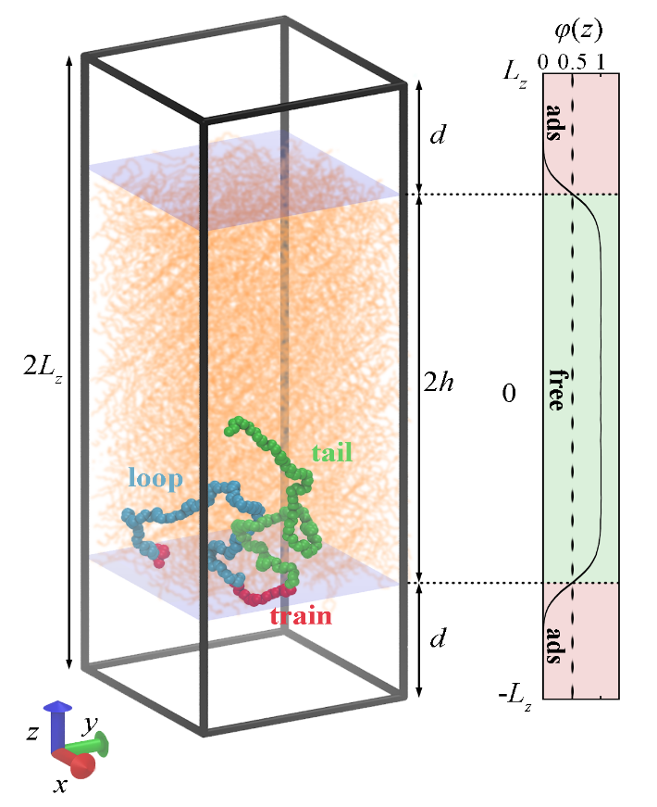
Self-consistent field theoretic modeling of polymers at interfaces
Tolis Lakkas, Constantinos Revelas, Aris Sgouros
Lakkas, A.; Sgouros, A.P.; DNT, Macromolecules 2019, DOI: 10.1021/acs.macromol.9b00795.

Slide 15
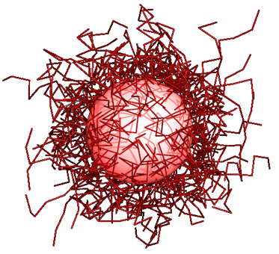
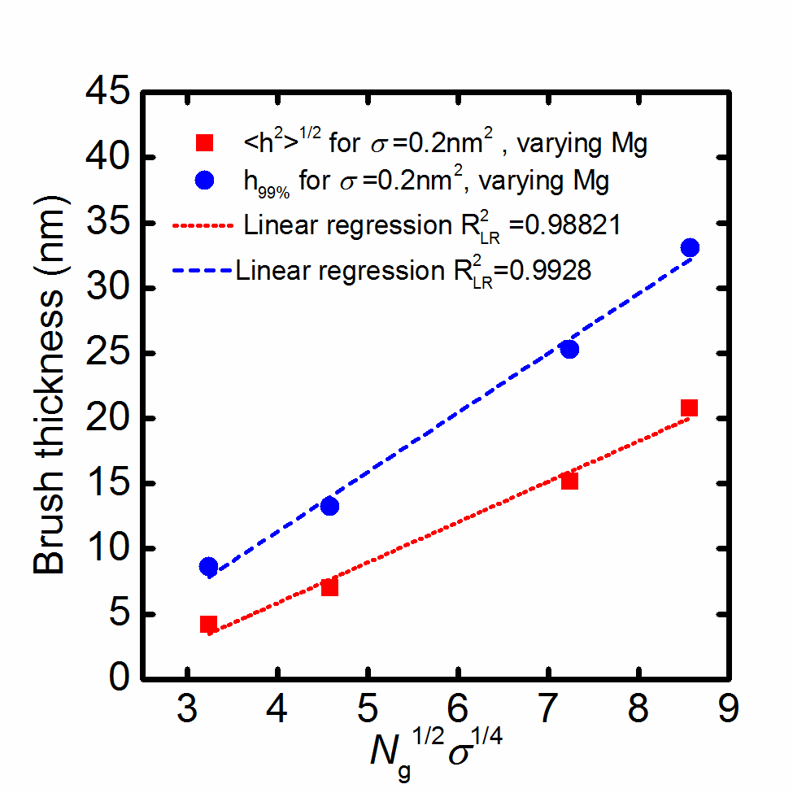
Self-consistent field theoretic modeling of polymers at interfaces
Solution of the SCF formulation in arbitrary geometries by the Finite Element method (SCF/FEM).
Application to polymer nanocomposites
SiO₂ in PS, R_{n}=8 nm M_{f}=100 kg/mol

Slide 16
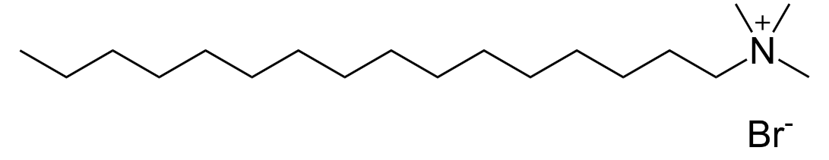
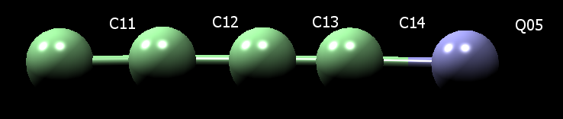
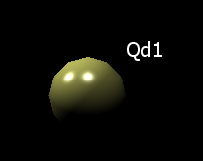
PHASE BEHAVIOR OF AQUEOUS SURFACTANTS
Stefanos Anogiannakis, Panos Petris
Cetyl-trimethyl-ammonium Bromide (CTAB)
“Dry Martini” implicit solvent Force Field
4 to 1 mapping – MARTINI CG particles
Wang, S.; Larson, R.G. Langmuir 2015, 31, 1262
cmc = 0.9 mM
Illa-Tuset, S.; Malaspina , D.C.; Faraudo, J. Phys Chem Chem Phys 2018, 20, 26422

Slide 17
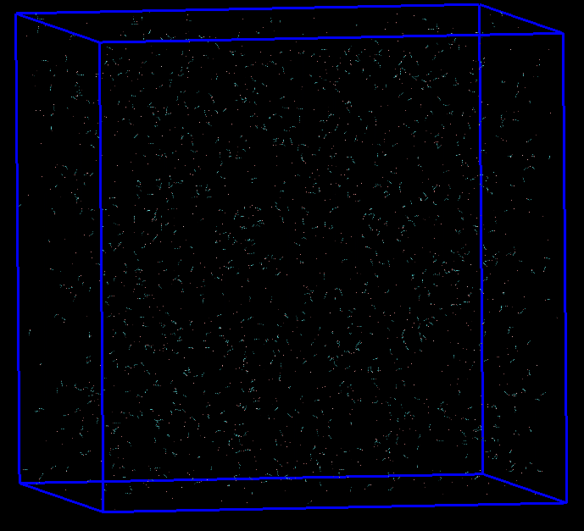
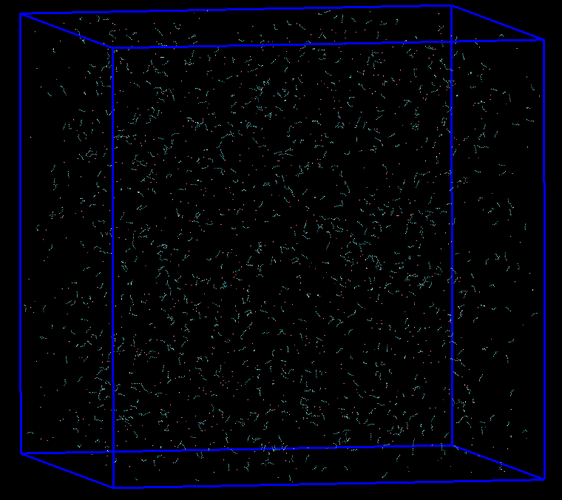
CTAB– CMC estimation
c = 0.5 mM
c = 1 mM
L = 118.42 nm
L = 149.19 nm
NO aggregates or very small aggregates with N_{agg} = 2-3 are continuously created and destroyed
● CMC Estimation from simulations:
0.5 mM < cmc < 1 mM
● Experimental Results: cmc = 0.9 mM

Slide 18
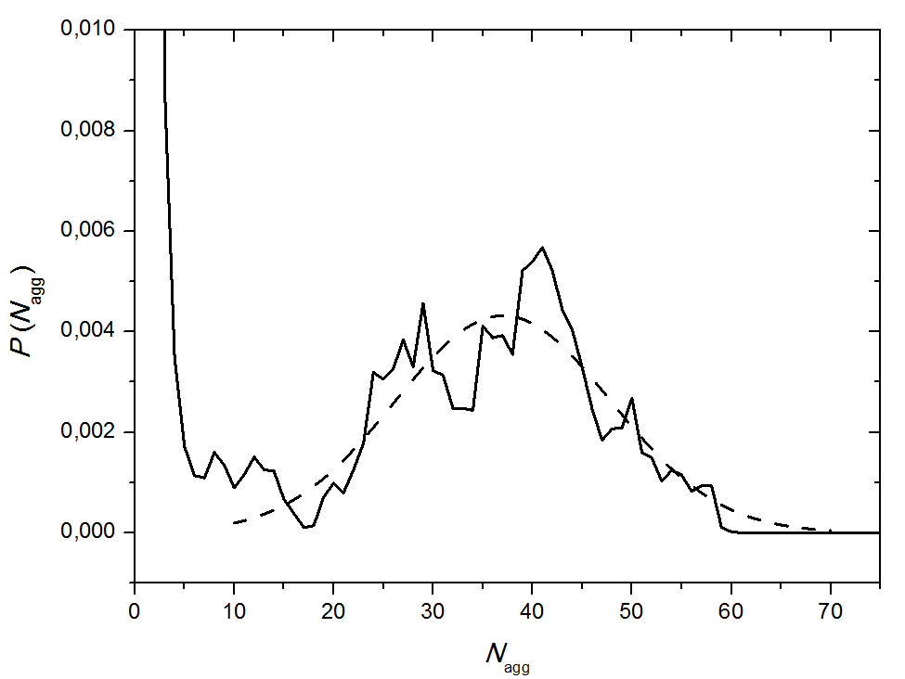
CTAB – Aggregation Number Estimation
Experimental: N_{agg, peak} = 44
Simulation: N_{agg, peak} = 38

Slide 19
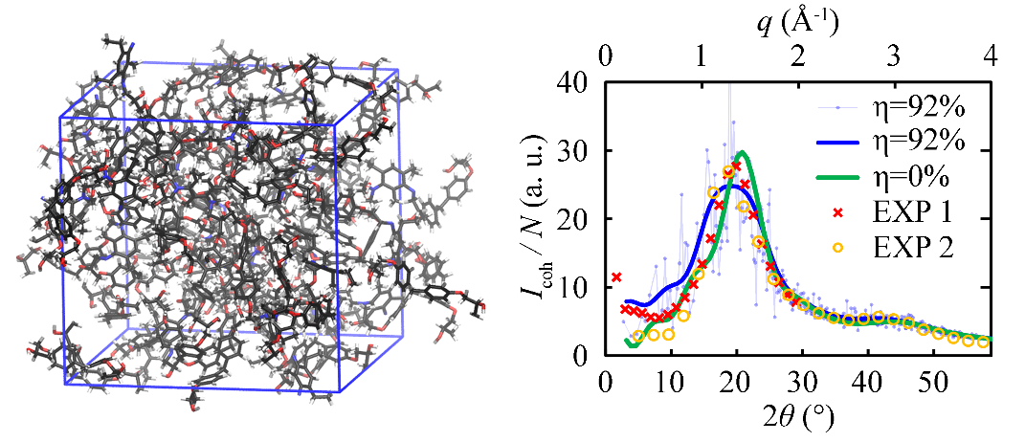
Atomistic Simulations of Epoxy Resins and Their Nanocomposites
Spyros Kallivokas, Aris Sgouros, Christina Zois
Kallivokas, S.V.; Sgouros, A.P.; DNT Soft Matter 2019, 15, 721.

Slide 20
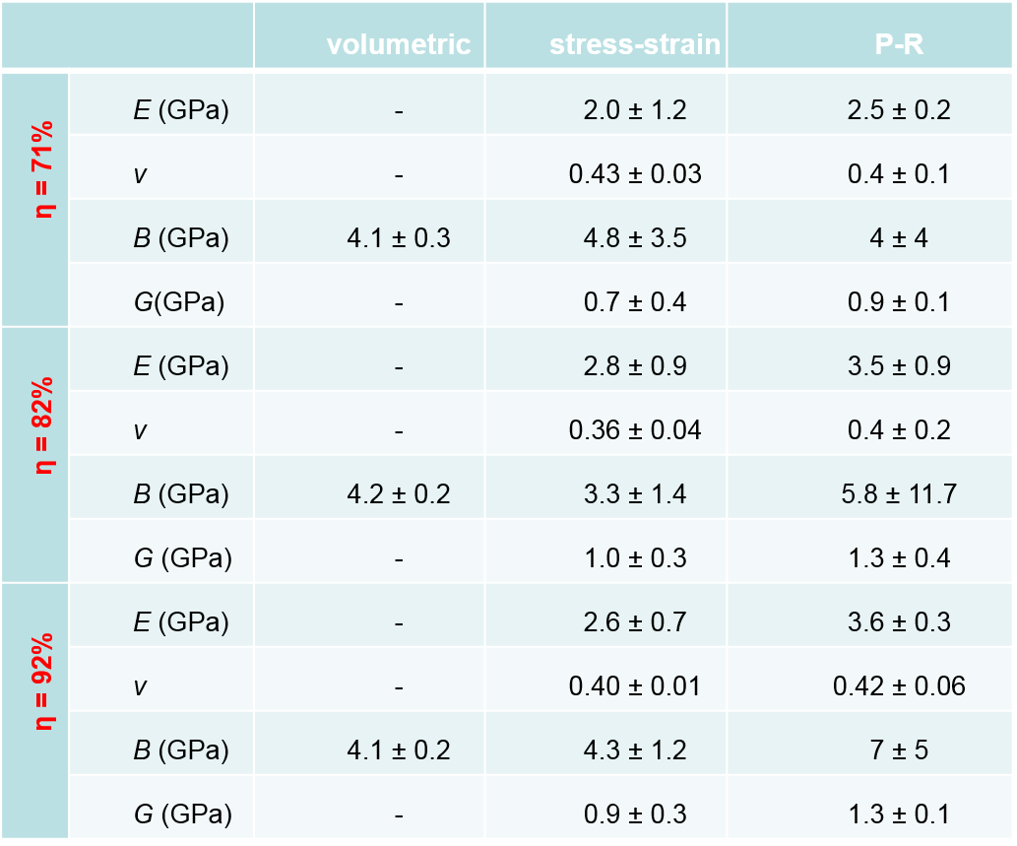
EPON-862/ DETDA Elastic Constants
E(GPa) | 2.56
ν | 0.35
B(GPa) | 2.9
G(GPa) | 0.95
Expt EPON-863 Tack, J.L., M.S. Thesis, Texas A&M U., 2006
Kallivokas, S.V.; Sgouros, A.P.; DNT Soft Matter 2019, 15, 721.

Slide 21
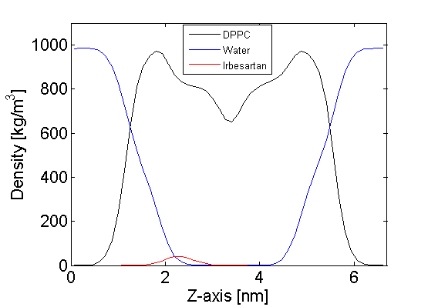
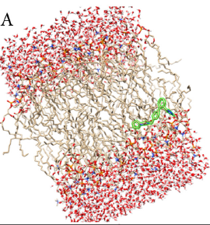
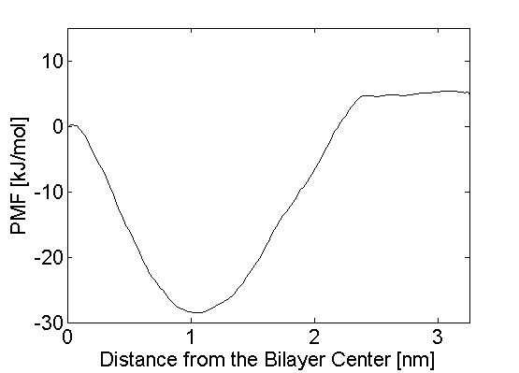
Drug molecules in cell membranes
Grigoris Megariotis
Irbesartan in DPPC bilayer membrane in water: MD and umbrella sampling simulations
Z-axis
Liossi, A. S.; Ntountaniotis, D.; Kellici, T. F.; Chatziathanasiadou, M. V.; Megariotis G.; Mania, M.; Becker-Baldus, J.; Kriechbaum, M.; Krajnc, A.; Christodoulou, E.; Glaubitz, C.; Rappolt, M.; Amentsch, H.; Mali, G.; DNT; Valsami, G.; Pitsikalis, M.; Iatrou, H.; Tzakos, A.; Mavromoustakos, T. Biochim. Biophys. Acta Biomembr. 2017, 1859, 1089.

Slide 22
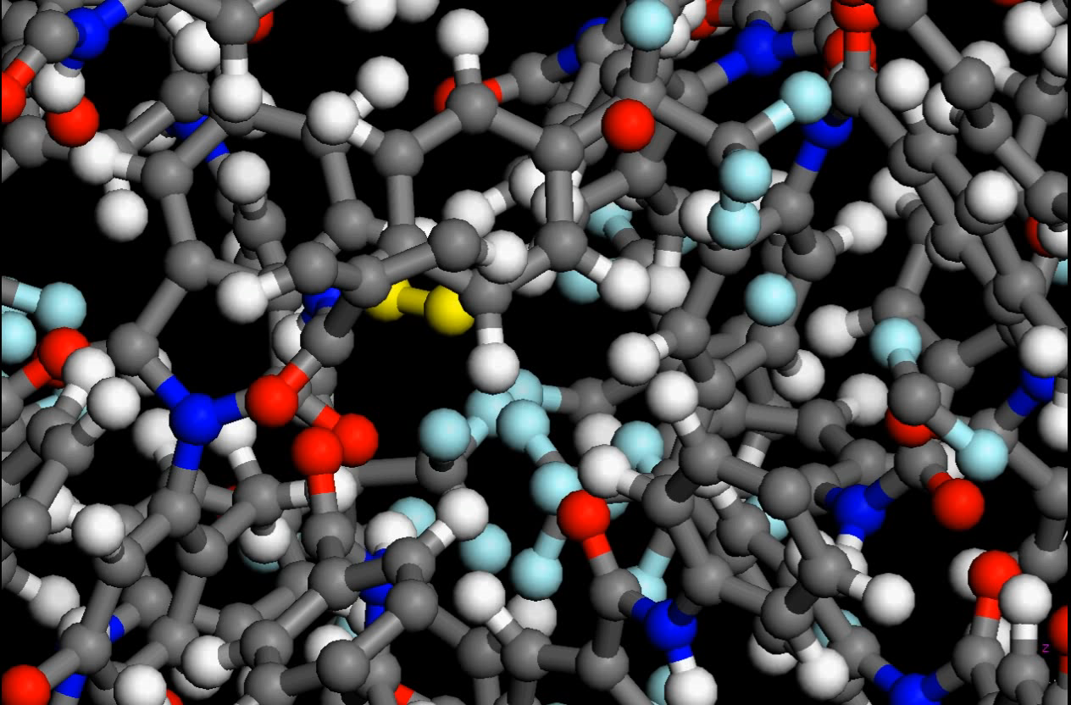
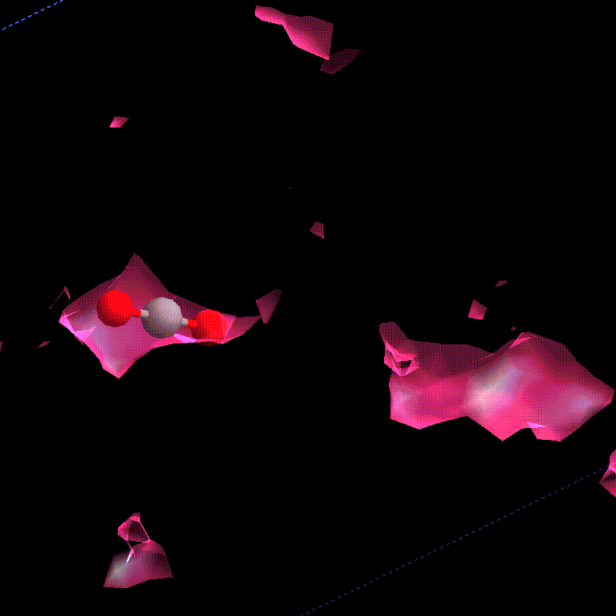
DIFFUSION OF GASES IN POLYMERS
†: Saddle point of V(r)
1: Local minimum of V(r)
Transition-State Theory provides an estimate of the rate constant k_{0→1} of an elementary jump in terms of the energies and eigenfrequencies at 0, †.
0: Local minimum of V(r)
CO₂ in PAI 300K N. Vergadou

Slide 23
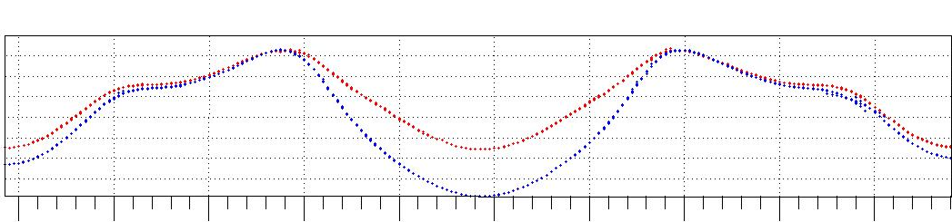
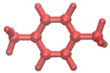
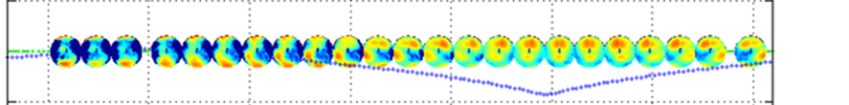
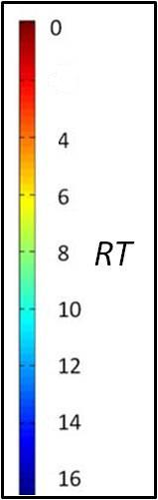
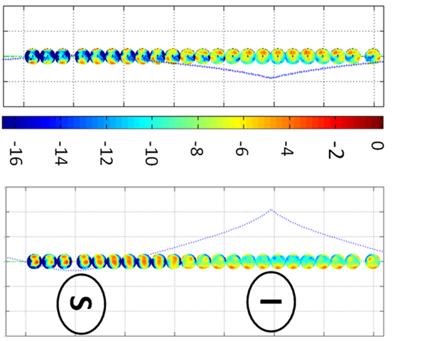
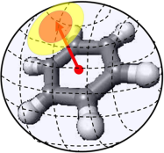

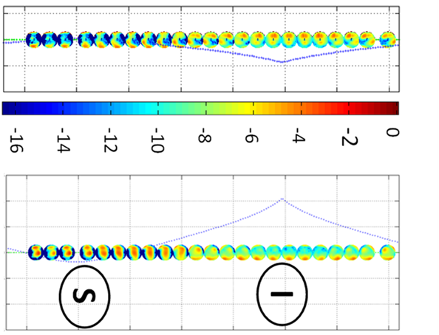
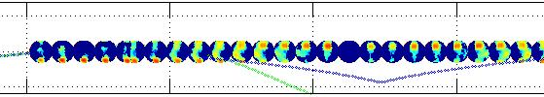

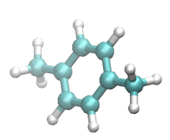
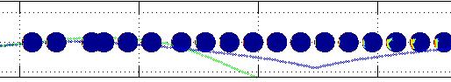


Benzene and p-Xylene in Silicalite, T=300 K
P.D. Kolokathis, G. Kali, H. Jobic, DNT. J. Phys. Chem. C 120, 21410-21426 (2016)
Free energy profiles along the straight channel:
10.0 11.0 12.0 13.0 14.0 15.0 16.0 17.0 18.0 19.0
0
-6
-12
10.0 11.0 12.0 13.0 14.0 15.0 16.0 17.0 18.0 19.0
10.0 11.0 12.0 13.0 14.0 15.0 16.0 17.0 18.0 19.0
S
I
S
Distribution of orientational free energy at different positions:
Color code
10.0 11.0 12.0 13.0 14.0 15.0 16.0 17.0 18.0 19.0
10.5
2
X(Å)
Normal to the ring
9.5
10.5
X(Å)
9.5
10.5
X(Å)
Methyl stem
9.5
10.0 11.0 12.0 13.0 14.0 15.0 16.0 17.0
ξ(Å)

Slide 24
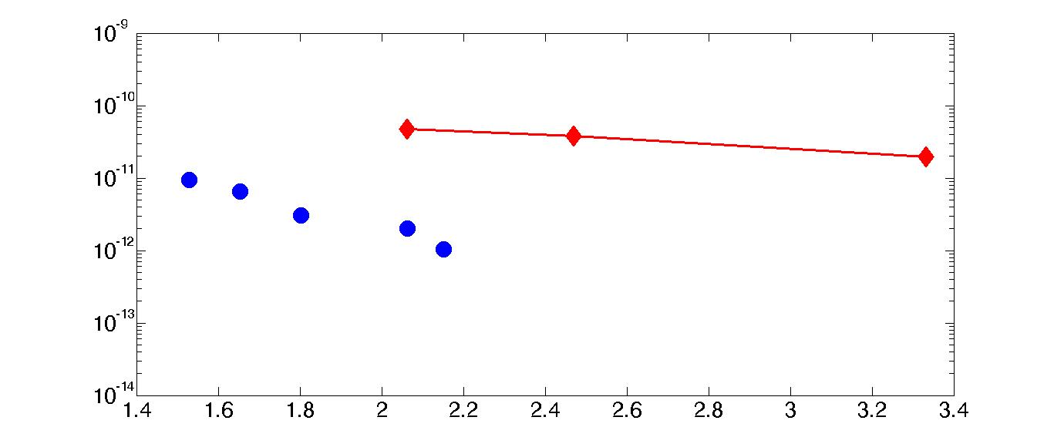
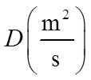

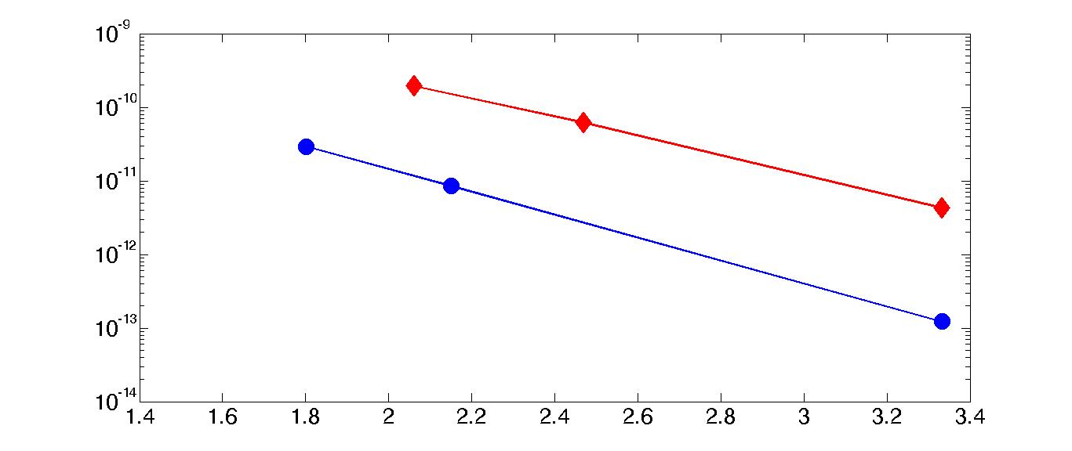

DIFFUSION COEFFICIENTS IN SILICALITE-1
Neutron Spin-Echo
Simulation

